Slide 1
Cottage Grove Street Improvement Ad Hoc Committee Report May – November, 2023
Faye Stewart
Public Works and community Development Director
City of Cottage Grove, Oregon

Slide 2
Cottage Grove Street Improvement Committee
City Council: Mayor Solesbee, Council President Ervin, Councilor Fleck, Councilor Stinnett, Councilor Savage, Councilor Merryday, and Councilor Dreher
Youth Advisory Council (YAC): Kassidy Poetzel
Community Members: Amber Bahler, Garland Burback, Jeff Conklin, Chris Holloman, Michael Laborde, Michael Praegitzer, Robert Reetz, and Tiffany Williams
City Employees: Faye Stewart, Mindy Roberts and Tina McDonald
Created with and by concerned City Councilors and Community members to investigate ways to fund the necessary street improvements in Cottage Grove in the most cost effective way.

Slide 3
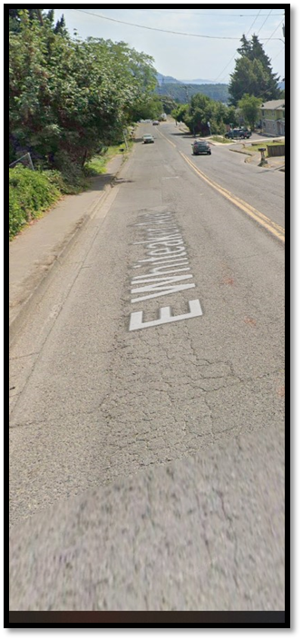
Vision and Objective:
Vision: Improve the quality of our streets through a fair and equitable use of funding means that improves and maintains the City streets to a PCI rating of 72 (good quality rating), with a priority on arterials and collectors, for the long term improvement of property values and livability in Cottage Grove.
Objective: To research and recommend an acceptable source of funding to the community and stakeholders that will supply the funds for the necessary street improvements. The goal is to support a level quality of 70 in the street Pavement Condition Index (PCI) for the arterial and collector roads.

Slide 4
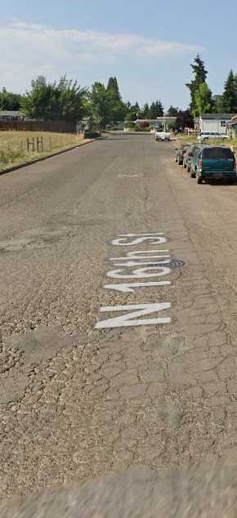
Challenges:
The City is unable to improve overall street conditions based on the projected revenue and costs allocated to maintaining and improving street surfaces
Lack of public awareness of the complexity of the problem and buy-in that the problem can only be solved with additional revenue sources
Materials and labor costs continue to rise with a decreased amount of tax dollars to fund
Bureaucratic hurdles and Federal ADA requirements supersede road repair funding
Inability to assess fees on commercial trucks and electric vehicles
The City of Cottage Grove, Oregon has 45.66 miles of paved and 4.63 miles of gravel roads supporting residents and business within the City limits.

Slide 5
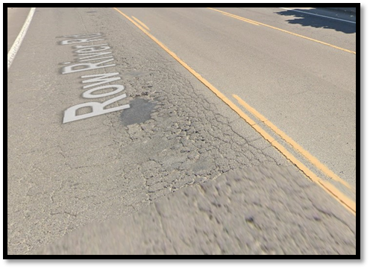
Street Ratings WHAT IS THE STREET PAVEMENT CONDITION INDEX?
The street Pavement Condition Index (PCI) in Cottage Grove is 55.4 (Low Fair)
Goal is a rating of 70 or higher, focusing on the arterial and collector roads first
To get to an overall PCI of 72 (Low Good) requires $35M invested over 10 years or 3.5M a year.
Currently the City of Cottage Grove budget can only contribute $400k per year.

Slide 6
Why are we concerned?
2023/2024 Street Budget:
Revenue: $1,873,000
Expense: $1,473,000 +
$400,000 Main Street Improvement (will go towards the PCI rate improvement)
Amount of capital investment to get PCI rating to 72 overall is $3,500,000 per year
3.5M reduced by $400k (improvements to PCI) leaves a $3,100,000 gap in funding
City of Cottage Grove Street Budget | 2023/2024
Revenue
Gas Tax ($.03) | $350,000
State Highway | $850,000
Federal Urban Aid | $145,000
Carryover | $525,000
Interest | $3,000
Grand Total | $1,873,000
Expenses
Operations (People + Material) | $707,000
Street Sweeper | $113,000
Chip Seal / Maintenance | $280,000
General Support | $117,000
Contingency | $226,000
Misc | $30,000
Sub Total
Main St / goes towards PCI improvement | $400,000
Grand Total | $1,873,000
Amount of capital investment to get PCI to 72 overall | $3,500,000
2023/2024 Gap ($3.5M reduced by $400k in improvements to PCI) | ($3,100,000)

Slide 7
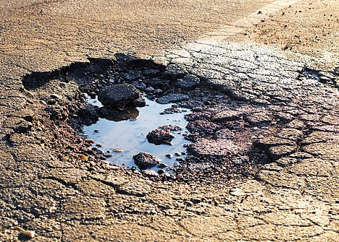
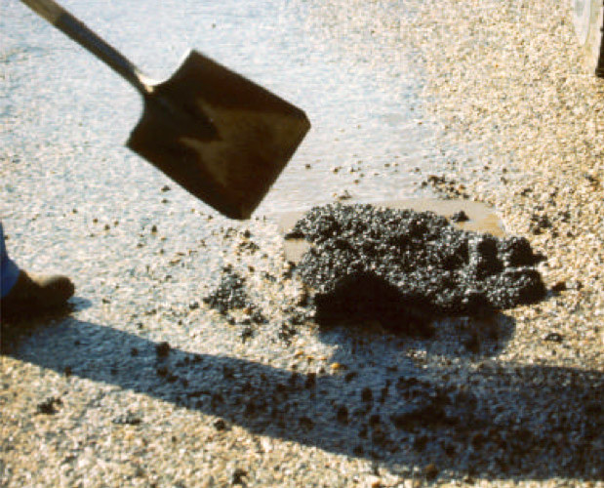
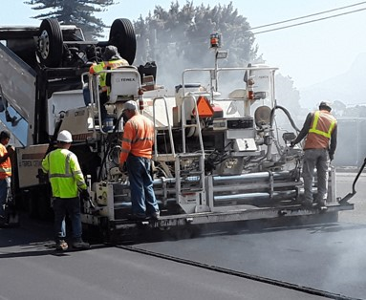
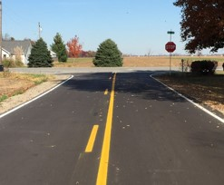
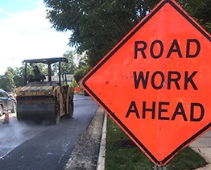
Potential Funding Options:
Ideas:
Continue preservation work & small improvements
Gas tax increase
Property Tax Increase
Payroll Tax Increase
LID
Grants
Transportation Improvement District
Custom License Plates
Photo Traffic Control
Road Use Fee
Option 1
Do Nothing
Option 2
Small incremental increases in Street funding
Option 3(a)
Create a suite of funding options to generate the $35M over a 10 year period
Option 3(b)
Use the suite of funding options in 3(a) and add a creative way to capture funding from external sources
Option 4
Reduce yearly increases of the suite of funding options but extend the timeframe to 15 to 20 years

Slide 8
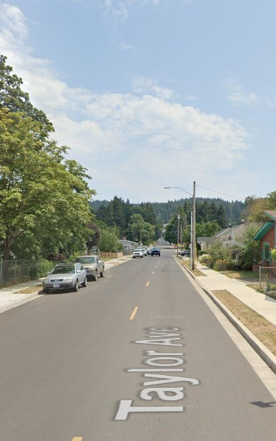
Next Steps:
Taylor Ave Cottage Grove after the Safe Routes to School Project
Create a suite of options to raise funds
Include the amount of increase and timeline
Put it out to a vote
Craft the solution with public input
Pursue State and Legislative options with Council direction
Continue with the Citizen Street Funding Oversight Committee

Slide 9
Budget Comparison with 10 year funding suite recommendations:
2023-2024
2024-2025
Revenue: $1,873,000
Expense: $1,473,000 +
$400,000 Main Street Improvement (will go towards the PCI rate improvement)
Amount of capitol investment to get PCI rating to 72 overall is 3,500,000 per year
3.5M reduced by $400k (improvements to PCI) leaves a $3,100,000 gap in funding
Revenue: $4,951,150
Existing Expense: $1,451,150 +
$196,850 (PCI improvement) +
$1,800,000 Arterials & Collector Road Improvement +
$1,503,150 LID - Local Road Improvements (City & Citizen funded)
Meets the required funding projection for the 10 year plan.

Slide 10
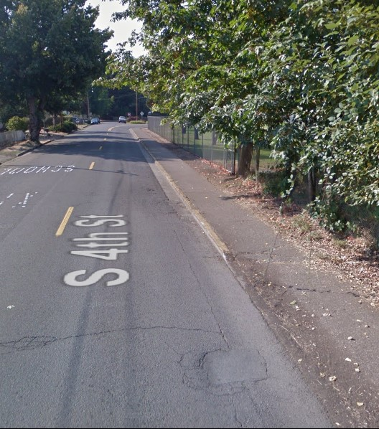
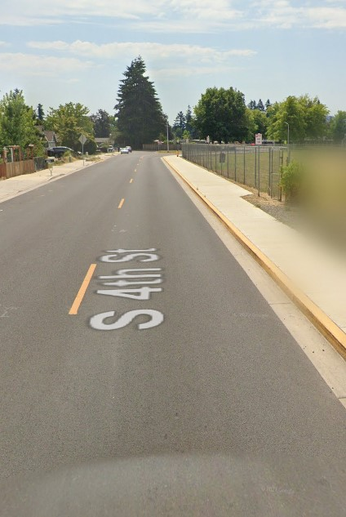
The City of Cottage Grove and the Ad Hoc Street Repair Funding Committee would like to hear from you
Options you support?
Options you oppose?
Additional ideas?
Please fill out the comment cards.
Before
After

Slide 11
Thank you for your time & support.
For questions or comments please contact:
Faye Stewart
Public Works and community Development Director
City of Cottage Grove, Oregon
PWDIRECTOR@COTTAGEGROVE.ORG
541-942-3349

